Slide 2
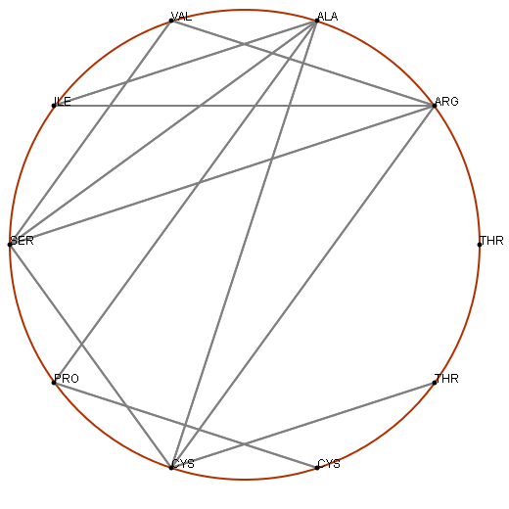
Open file
Save figure
distance threshold
7

